Slide 1
Keypoint extraction for sign language recognition
Project progress checkup
Group 2 · DATA 255 · SJSU Fall 2026
Siva Surya Chandran · Sharan Lourduraj · Timothy Song · Rohil Utture · Sri Prajeet Villyal
Notes:
(~10 s) Progress checkup for Group 2. Flow: the problem, existing work and gaps, datasets and metrics, our approach and what is new, then progress and what remains. 7 minutes in total.

Slide 2
Domain and problem
Video is high-dimensional.
Meaning sits in the hands, the mouth and the body together.
Word-level sign language recognition
1
Similar signs differ in small details.
A single frame is often not enough to tell them apart.
Computer vision for accessibility: classify a short ASL clip as one of 100 words.
2
Real video is imperfect.
Hands get occluded, motion blurs and frames drop.
Our target: stay accurate when the video is imperfect.
3
Notes:
(~40 s) The domain is video understanding for accessibility: recognising isolated ASL words. Three challenges: high-dimensional video, signs that differ in small hand and mouth details across frames, and real-world video quality (occlusion, blur, dropped frames). Our goal is a pipeline that stays accurate when video is imperfect.

Slide 3
Existing work and gaps
What exists
Gaps we target
Appearance-based: I3D and VGG-GRU learn from raw frames.
Pose-based: Pose-GRU and Pose-TGCN take 55 OpenPose body and hand points.
Prebuilt extractors: OpenPose and MediaPipe, used as fixed tools.
1
The keypoint extractor is a fixed, prebuilt tool, not a learned part of the pipeline.
2
Pose baselines use no mouth shape.
3
Results are reported on clean video.
Notes:
(~50 s) Source: Li et al., WLASL (WACV 2020). Appearance-based baselines are I3D and VGG-GRU; pose-based baselines are Pose-GRU and Pose-TGCN, which use 55 OpenPose keypoints (13 upper-body joints plus 21 per hand). OpenPose and MediaPipe are widely used prebuilt extractors. The gaps are our framing of what these baselines leave open: a fixed extractor, no mouth shape in the pose input, and results on clean video.

Slide 4
Datasets and metrics
Datasets
Top-1 accuracy on WLASL100 (%)
WLASL100: 100 words, 2,038 videos, 97 signers. Official train, val and test splits.
COCO-WholeBody: whole-body keypoints that train Stage 1.
Metrics
Words: top-1, top-5, macro-F1.
Keypoints: PCK and NME.
Published: Li et al., WACV 2020 (grey). Ours: mean of 5 seeds on clean test clips.
Notes:
(~50 s) Published WLASL100 top-1 / top-5 (Li et al., WACV 2020, Table 3): VGG-GRU 25.97 / 55.04, Pose-GRU 46.51 / 76.74, Pose-TGCN 55.43 / 78.68, I3D 65.89 / 84.11. Our keypoint-only Frame-only model is in the range of the published pose-based baselines. The comparison is indicative: our training setup and keypoint extractor differ. Keypoint metrics: PCK is the fraction of points within a distance threshold; NME is the mean localisation error. WLASL is C-UDA licensed, so clips stay private.

Slide 5
Our approach: the pipeline
Video
Stage 1
Stage 2
Stage 3
Word
16 sampled frames
Keypoint extractor, 73 points
Temporal refiner fixes weak points
bi-GRU classifier
One of 100 signs
Progress on Stage 1
95.2%
97.6%
Raw-frame baseline
ImageNet ResNet-18 on pixels, then the same bi-GRU head
PCK@0.1 on COCO val
PCK@0.2 on 100 hand-labeled WLASL frames
Notes:
(~60 s) Stage 1: ResNet-50 (ImageNet-initialised) plus three deconvolution layers produces 73 heatmaps (11 upper-body, 20 mouth, 21 per hand); the deconv keypoint head is trained from scratch on COCO-WholeBody, 140 epochs at 256x192. COCO val: PCK@0.1 95.2% overall (upper body 95.1, mouth 99.2, left hand 93.6, right hand 93.3), PCK@0.05 90.4%, NME 0.030. On our 100 hand-labeled WLASL frames (90 scored, error as a fraction of shoulder width) PCK@0.2 is 97.6% and PCK@0.1 is 71.7%. Stage 2 repairs points with confidence below 0.2. Stage 3 is a two-layer bi-GRU over 16 frames. Everything is trained on clean data only.

Slide 6
What is new compared with prior work
Prior work | Our approach
Keypoints from a prebuilt extractor | A learned extractor trained on COCO-WholeBody: 73 points, including the mouth
Evaluated on clean video | A stress test: occlusion, blur and missing frames at three severities
Bad keypoints are passed on as they are | Stage 2 refiner trained on keypoints from really degraded frames
Pixels and keypoints rarely compared under the same damage | A raw-frame baseline run under identical damage
Since the proposal: a bi-GRU replaced plain frame pooling, and Stage 2 and the robustness test were added.
Notes:
(~50 s) Each row pairs a limitation of existing pipelines with what we do about it. The keypoint head is trained from scratch, but the ResNet-50 backbone starts from ImageNet weights, as does the raw-frame baseline. The proposal planned plain frame pooling; the bi-GRU, Stage 2 and the robustness question were added as the project developed.

Slide 7
Progress: stress test and models
Degradation | What it does | Mild · Moderate · Severe
Occlusion | Grey square over one hand | Square side 20% · 25% · 30% of frame
Motion blur | Random-angle linear blur | Kernel 7 · 13 · 21 px
Missing frames | Frame replaced by black | Only the hit frames affected
Models compared
Frame-only
Stage 3 on Stage 1 keypoints
+ Interpolation
Fills weak points, no training
+ Temporal
Refiner trained on synthetic noise
Proposed
Refiner trained on real degraded frames
Raw-frame CNN
ResNet-18 on pixels
Identical damage for every model (seeded per clip) · 10 conditions: clean + 9 · 25% / 50% / 75% of frames hit · 5 seeds.
Notes:
(~40 s) Degradations are applied to the frames before Stage 1, with the same seeded damage for every model. Occluders are placed on the clean Stage 1 wrist positions. All models are trained on clean data only; the Proposed refiner is the only one trained on keypoints from really degraded frames. Interpolation follows Roh et al. 2024. 5 seeds vary Stages 2-3 and the raw-frame model; Stage 1 is one checkpoint.

Slide 8
Results: where robustness shows up
Top-1 drop, clean to degraded average
-6.6
Proposed
-9.1
Raw-frame
-12.9
Frame-only
Notes:
(~50 s) Top-1 on the 258 test clips, mean over 5 seeds. The Proposed model loses the least under degradation. At severe blur, severe occlusion and missing frames it leads clearly; on clean clips it is level with Frame-only. Full table with mean and std is on a backup slide.

Slide 9
Takeaways and what remains
What the results say
Still to do
Proposed is the most robust: it loses 6.6 points, Frame‑only loses 12.9.
Gains grow with the damage. No win on clean or mild: within one std.
Real degradations matter: a refiner trained on synthetic noise does not help.
Pixels vs keypoints: the raw-frame CNN is lower overall, but its drop (9.1) is smaller than Frame‑only's.
Compare with MediaPipe and RTMPose
1
NPU run on Mobilint
2
Final report and slides
3
Notes:
(~55 s) The gap between Proposed and Frame-only on the degraded average is several standard deviations wide. On clean clips and at mild occlusion or blur the differences are within one std, so we do not claim a win there. +Temporal learned to undo synthetic keypoint noise, which does not resemble keypoints from truly blurred, occluded or missing frames. Still to do before the final: the MediaPipe and RTMPose comparison, the Mobilint NPU run (waiting on a lab run), and the final report with all numbers regenerated from robustness.csv. Limitations are on a backup slide.

Slide 10
Backup: full results table
 | Frame-only | + Interp. | + Temporal | Proposed | Raw-frame CNN
Clean | 49.5 ± 1.3 | 46.7 ± 1.5 | 46.4 ± 1.5 | 48.8 ± 2.6 | 39.0 ± 1.6
Occlusion, severe | 31.7 ± 0.8 | 31.7 ± 2.2 | 29.8 ± 1.2 | 36.4 ± 1.3 | 23.4 ± 3.1
Blur, severe | 31.5 ± 2.1 | 29.8 ± 1.4 | 32.6 ± 0.8 | 40.0 ± 1.2 | 16.9 ± 3.5
Missing, moderate | 31.7 ± 3.3 | 36.4 ± 1.4 | 28.2 ± 4.5 | 42.8 ± 1.9 | 32.6 ± 1.1
Missing, severe | 13.8 ± 3.1 | 25.0 ± 2.0 | 12.4 ± 2.5 | 29.5 ± 2.2 | 20.5 ± 0.9
Average, 9 degraded | 36.6 ± 1.3 | 37.5 ± 1.4 | 34.6 ± 1.0 | 42.2 ± 1.7 | 29.9 ± 1.2
Drop, clean to degraded | -12.9 | -9.2 | -11.8 | -6.6 | -9.1
Top-1 (%), mean ± std over seeds on the 258 test clips; best per row in bold. Raw-frame CNN: 5 of 5 seeds. Chance is 1%.
Notes:
Full 10-condition table: runs/seeds/robustness_mean_std_top1.md. One test clip is about 0.4 points, so differences of a point or two are noise.

Slide 11
Backup: limitations
1
One Stage 1 model
2
Small test set
3
Signers overlap
Seeds vary Stages 2-3 and the raw-frame CNN only.
258 clips, so one clip is about 0.4 points.
98% of test clips come from signers also seen in train.
4
Synthetic damage
5
Pretrained backbone
6
One dataset
Grey squares, linear blur and black frames.
ResNet-50 starts from ImageNet, like the baseline.
WLASL100 only; no signer-independent split.
Notes:
We used the official WLASL splits so results compare with the literature. A signer-disjoint split is harder and would be a follow-up. The deconv keypoint head is trained from scratch; the backbone is ImageNet-initialised.

Slide 12
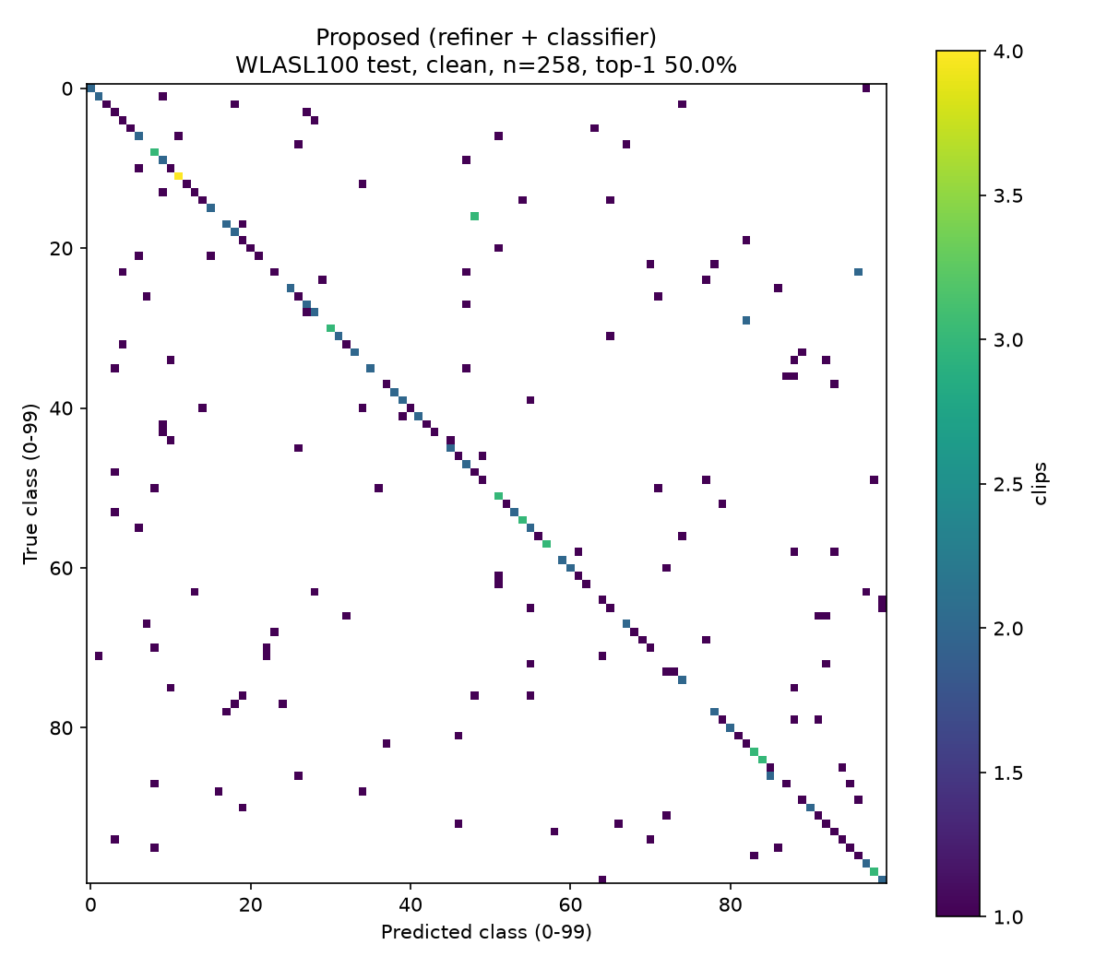
Backup: where errors land
50.0%
top-1 on 258 clean test clips
17 / 19
words always right / never right (2+ test clips)
Spread out
no single class dominates the errors
Common slips: candy → hearing (3×), thanksgiving → tell, dance → study, computer → work (2× each). Only 2 to 4 test clips per word.
Notes:
Why only about 50%? 100 classes, roughly 14 training clips per class, keypoints only with no appearance, and a from-scratch head. This project measures robustness, not state-of-the-art accuracy.

Slide 13
Backup: Stage 1 by body group
PCK@0.1 on COCO val (%)
ResNet-50 (ImageNet init) + 3 deconv layers, 73 heatmaps, 140 epochs, 256×192 input. PCK@0.05 90.4%, NME 0.030.
Notes:
On our hand-labeled WLASL frames (90 of 100 scored, error as a fraction of shoulder width) PCK@0.2 is 97.6% and PCK@0.1 is 71.7%.

